Slide 1
Version Control Introduction

Slide 2
What is version control/ source code management (SCM)
Version control is a system that records changes to a file or set of files over time so that you can recall specific versions later.
In other words we can say that version control is a system to help us keep history of resources of a project in a manner, so it could be use or examine later.
Basically Its keep backups of all updates/backups of each state of the project, we can see every edit, addition or deletion, when it was made and by whom.

Slide 3
Manual method to keep backup of Projects
Keep in folders, named on date of last updation i.e 01122022 at local / production environment.
Keep copy of file by put postfix as date of last updation i.e. filename_01122022.php at local / production environment.
Keep folder/directories of projects in central backup of organization in compressed format.

Slide 4
Drawback of Manual method to keep backup
It sometimes lead to confusion which file to use and which not
No system to keep order in time
No system to identify which files were updated in a release.
No automatic system to rollback from one version to another version.

Slide 5
Manual method to manage files of project
Update project files using FTP tools such as filezilla, winscp etc
Update project files using command line terminal.

Slide 6
Drawback of Manual method to manage files of project
It requires to share credentials of server with all developers.
Developer should be very careful at the time of deployment in production environment, as by mistake any file can be overwritten or deleted.
Hard to track down activity logs.

Slide 7
Some version controls systems
Git
SVN
CSV
TFS
Mercurial
Why Git Not others- git is suitable for current development scenario of MPHC

Slide 8

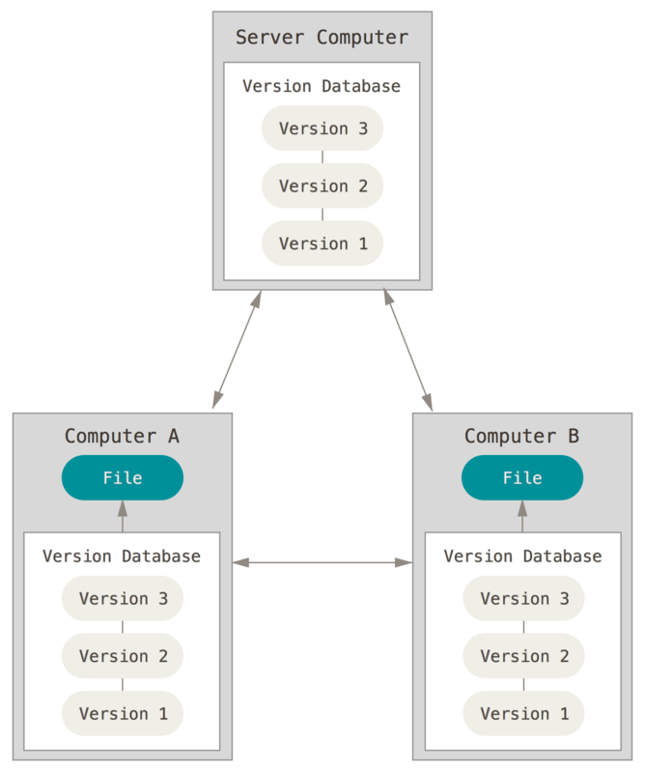
Introduction of git
Git is a open sourced distributed/ decentralized version control
system
It means each user
have all versions of project
at his/her local
Environment.

Slide 9
History of Git
Git was developed by Linus Torvalds in 2005 for development of the Linux kernel (same person who created linux operating system).

Slide 10
Basic Etymology of Git
There are some important terms to know to work on git system. Some of them are mentioned as follows
Repository – Git repository is collection of all resources of git project, there could be a central repository and local repositories at developer’s end.
Commit – Set of changes by developer each labelled by him/her as per changes made in files in local environments.
Push – Push is activity to send commit/commits to central repository of Git.
Branch – A branch in Git is a pointer to one of these commits. The default branch name in Git is main.
Checkout – Checkout is activity to bring specific branch to work on in Git
Working directory – folder/directory of git project in local environment
Tracking index – index of all those file in workging directory which are added to be tracked

Slide 11
Atomic function of git commit cyle
Flow of git is as follow
Develop initiate day’s work.
He/she modified file/multiple files.
He/she update file/files at central repository of git.
Same changes would update in configured deployment server.

Slide 12
Benefit to Use Git
It provides various tools to track allover development of project.
It keep individual activities logs of team members in project.
Data for analysis of modules over time.
Automated versioning of code
Automatic deployment to server instead of manual uploading.
Hence it prevent issues usually we face in manual upload such as deletion of important file/s by mistake, not taking backup, upload wrong files etc.
Keep development as per standard pattern.
Provide easy code comparison environment.

Slide 13
Resources to Begin
Github.com – for practice git’s various activities
E-Book for git https://github.com/progit/progit2/releases/download/2.1.360/progit.pdf

